Slide 1





IoT Assignment 2

Slide 2



Jun Wei
P1807000
Gavin
P1806984
Nathan
P1846528

Slide 3









Agenda
Overview
Architecture
Hardware
Features
Conclusion

Slide 4
Our Project
Title | Grab Safety System By the Explorers
Target Audience | Grab Operators within the command centre to monitor their drivers
Features | Cloud Based Hosted Web Server Use of Raspberry Pi Cam Able to activate real time video streaming Use of Machine Learning model to predict booking safety Taking images using picam/Webcam and send it to AWS Rekognition to view drivers mood and age Send Telegram Alerts to drivers when required Login and Registration function through the use of DynamoDB Full MQTT Web Server Able to display data stored in DynamoDB out in a responsive web portal.

Slide 5
Overview
For this assignment our team added bonus features besides implementing basic requirements
Our Bonus features are:
Intermediate, Taking images from raspberry Pi Cam and sending it to S3 bucket and rekognition to predict users mood and age.
Intermediate, Live streaming a feed from raspberry Pi Cam onto the web server directly showing the Camera image in 30 FPS.
Intermediate, use of 3 ensemble model to achieve a good accuracy on the Machine Learning model.

Slide 6







Architecture
Storage
Hardware
Live Stream from Motion Library
AWS DynamoDB
S3 Bucket
Pi Cam
Cloud Hosting
AI algorithm
Data from DynamoDB
Prediction Output
Machine Learning Model
User Access EC2
EC2 Cloud Server
Web Server

Slide 7
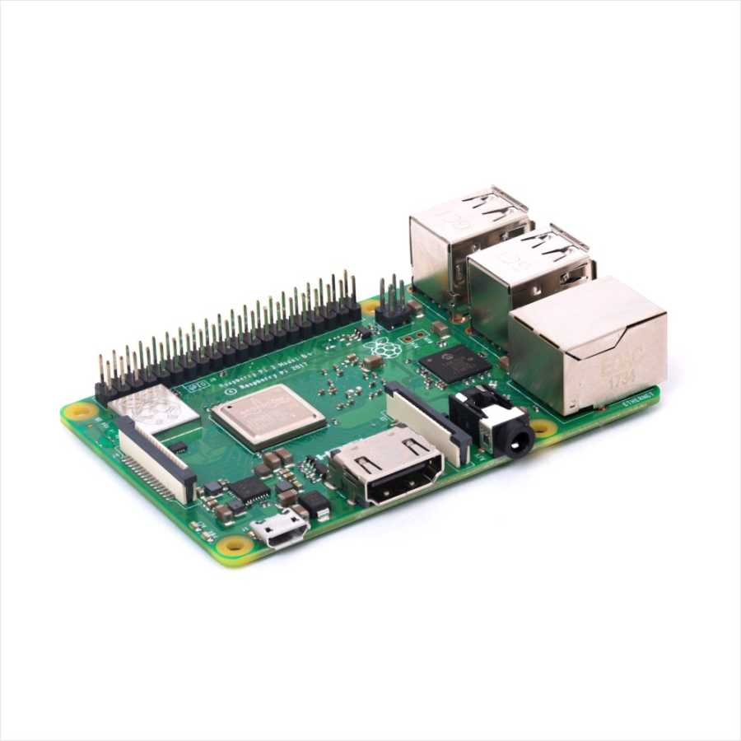
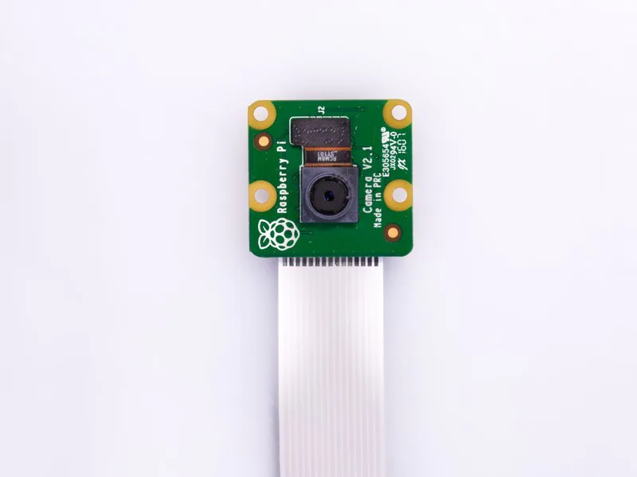
Hardwares used
Raspberry pi 3 model b
PIcamera v2.1

Slide 8




Modules used
Boto3
Scikit Learn
Numpy
picamera

Slide 9
Demonstration of Software

Slide 10
Contribution by Jun Wei
Conversion of MQTT on Dashboard, Show Booking and Speed check pages.
Created a DynamoDB table to store all the telemetry data
Created the AI Model for the use of safety prediction
Implementing the AI model into flask
Worked with Gavin on Raspberry Pi Cam
Live Streaming of the driver
Taking images of the driver

Slide 11
Contribution by Gavin
Conversion of MQTT on the Login and Register pages.
Created a DynamoDB table to store the login credentials of users
Setting up and hosting the web application on the Cloud.
Worked with Jun Wei on the Raspberry Pi Cam
Live Streaming of the driver
Taking images of the driver

Slide 12
Contribution by Nathan
Design and create the facial recognition web page
Create S3 bucket for facial recognition
Create APIs for
Capture the driver’s facial feature
Rendering all images that were saved
Select specific image and send it to AWS S3 bucket to do AI facial recognition and output the meaningful data (driver’s age and current emotional state)

Slide 13
Areas of improvements for the app
Due to time constraints, there were few features our team did not manage to implement:
A buzzer to sound when a driver hits the speed limit of 80km/hr
Using a temperature sensor to detect the humidity of the weather
More feature cleaning can be done to AI model if given more time

Slide 14
Conclusion
To conclude, our web application is useful for the Grab analysts to:
Keep track of the speed of different drivers
Sending alerts to warn drivers if they are speeding
Any questions about our system, contact us at:
gavintan.18@ichat.sp.edu.sg
nathanwang11.18@ichat.sp.edu.sg
junwei.18@ichat.sp.edu.sg

